Slide 1

Phase 5: Test
(or, OBSERVE again!)
The key to user testing is listening
Ms Rosetha Kays (Namibia University Of Science and Technology)
Ms Josephina Muntuumo (Namibia University Of Science and Technology)

Slide 2
Testing Stage Outline
Recap on empathise, define, ideate and prototype stage
What is Testing?
What is the Test mode?
WHY test?
HOW to test?
How do we visualize prototypes for tests in digital tools?
Testing Methods
Summary
The Takeaway
Task One
Further Reading
References
Questions

Slide 3

Recap on empathise, define, ideate and prototype stage

Slide 4
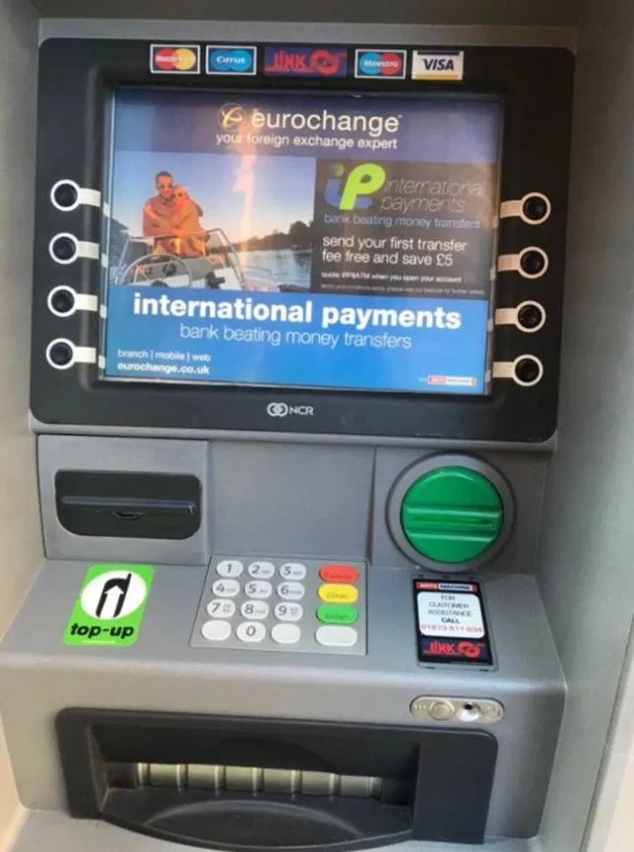
2. What is Testing?
“Testing is an opportunity to learn about your solution and your user(s).”
How will you go about testing the design of an ATM on your left ?
Who are the potential users and critical stakeholders for testing, refinement, and evaluation?
What tools can you use to carry out the test?
What type of feedback are you likely to receive?
Notes:
For an interface to be a success, it must provide the right functionality, at the right time, in the right place, and in the right form from the user’s point of view. • Such interfaces are called usable. • Example: if we are designing an ATM, we should be able to justify each user action: – Insert card? – Enter PIN? – Press Quick Cash key? – Press Okay? – Remove card? – Remove money? – Remove receipt?

Slide 5
3. WHAT is the Test mode
The Test mode is when you solicit feedback, about the prototypes you have created, from your users and have another opportunity to gain empathy for the people you are designing for.
Testing is another opportunity to understand your user, but unlike your initial empathy mode, you have now likely done more framing of the problem and created prototypes to test.
Both these things tend to focus on the interaction with users, but DON’T reduce your “testing” work to asking whether or not people like your solution . Instead, continue to ask “Why?”, and focus on what you can learn about the person and the problem as well as your potential solutions.
Ideally you can test within a real context of the user’s life.
Notes:
The Testing stage
The purpose of testing is to learn what works, and what doesn’t and then iterate.
It involves producing user feedback as related to the prototypes you have developed, as well as
earning a deeper comprehension of your users.
Testing is an essential step in the design thinking process.
Not infrequently, decisive change proposals appear during this phase that could enhance the quality of the end result substantially.
In particular, the fresh views of people who were not involved in the development of the prototype and thus are much freer in their assessment can pay off quite well in the end. They can see prototypes through the eyes of a customer or user.

Slide 6
… WHAT is the Test mode
For a physical object, ask people to take it with them and use it within their normal routines. For an experience, try to create a scenario in a location that would capture the real situation.
If testing a prototype in situ is not possible, frame a more realistic situation by having users take on a role or task when approaching your prototype.
A rule of thumb: always prototype as if you know you’re right, but test as if you know you’re wrong—testing is the chance to refine your solutions and make them better.
Notes:
Negative feedback is your way to learn and improve. We always receive valuable feedback when we test prototypes with customers in the real world, namely potential users or in the environment of the users.
This is to address any areas of concern and determine whether a proposed solution is plausible and valuable.
The team must take the proposed solution to users and other critical stakeholders for testing, refinement, and evaluation.
This need not be a highly formal or structured process, at least early on, nor should it be a one-time effort.
Instead, user and stakeholder engagement should be done as soon as possible and iteratively as the solution takes shape.

Slide 7
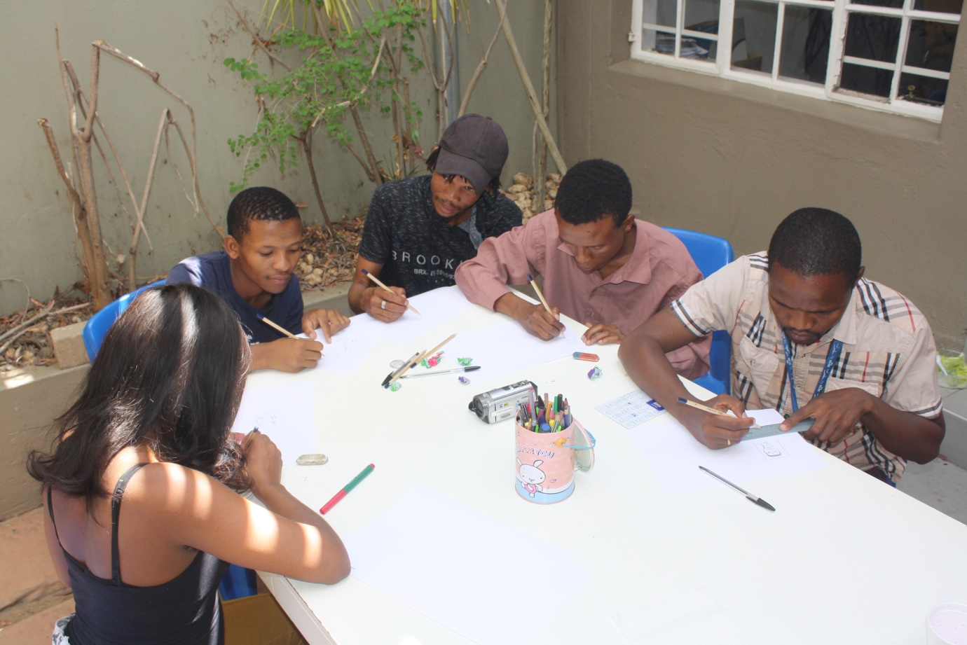
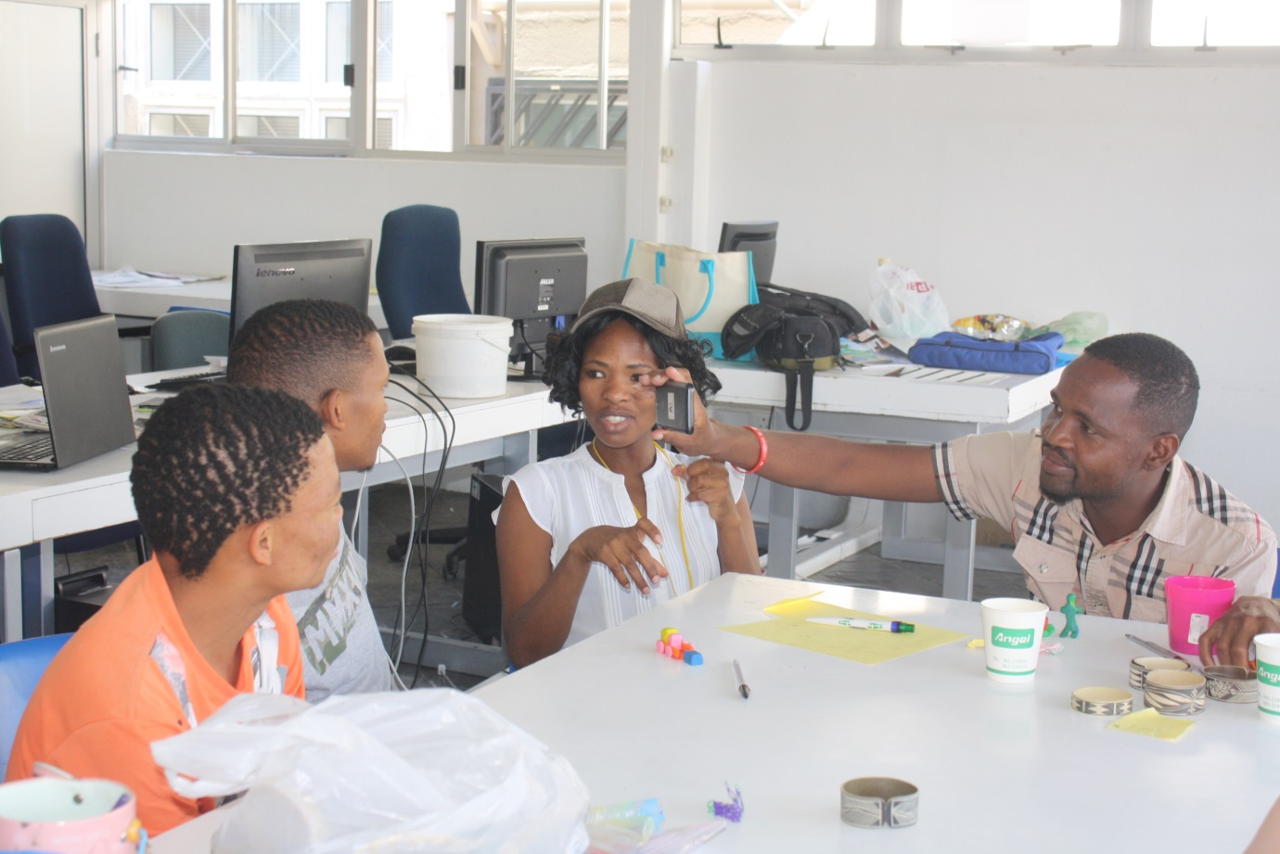
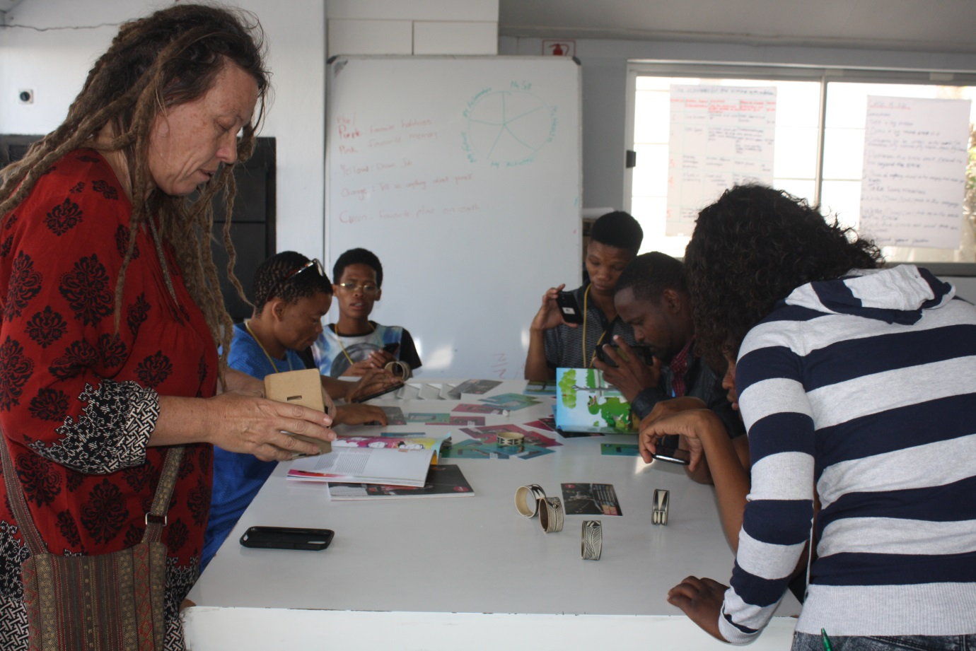
4. WHY test?
To refine prototypes and solutions. Testing informs the next iterations of prototypes. Sometimes this means going back to the drawing board.
To learn more about your user. Testing is another opportunity to build empathy.
Observation and engagement—it often yields unexpected insights.
To refine your (Point Of view) POV. Sometimes testing reveals that not only did you not get the solution right, but also that you failed to frame the problem correctly.
Notes:
Whenever possible, we collect and analyse data to validate the results.

Slide 8
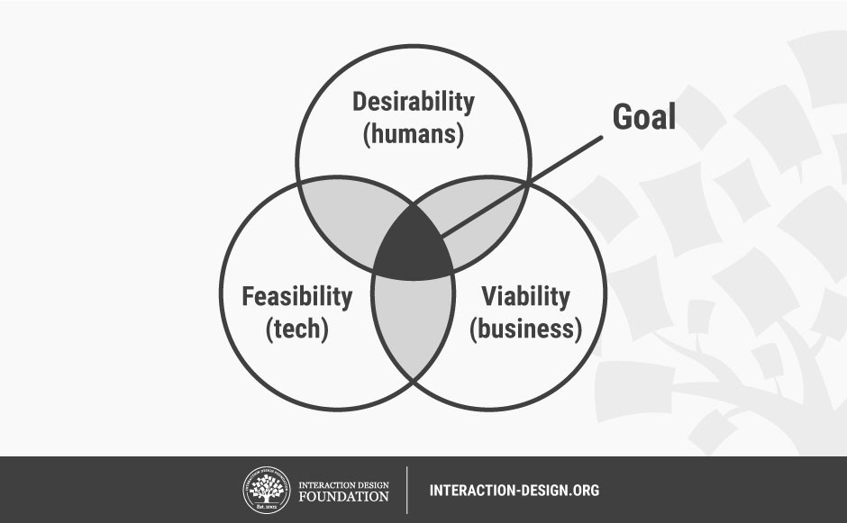
The End Goal: Desirable, Feasible, and Viable Solutions
Notes:
Design Thinking is a human-centered design process that may not have a fixed sequence of steps, but will certainly have an ideal end point. The end goal of every Design Thinking project is to design a solution that satisfies the tests of desirability, feasibility, and viability.

Slide 9
5. HOW to test?
Show don’t tell. Put your prototype in the user’s hands – or your user within an experience. And don’t explain everything (yet). Let your tester interpret the prototype. Watch how they use (and misuse!) what you have given them, and how they handle and interact with it; then listen to what they say about it, and the questions they have.
Create Experiences. Create your prototypes and test them in a way that feels like an experience that your user is reacting to, rather than an explanation that your user is evaluating.
Ask users to compare. Bringing multiple prototypes to the field to test gives users a basis for comparison, and comparisons often reveal latent needs.
Observe
Ask follow up questions
Notes:
1.Let your users compare alternatives
Create multiple prototypes, each with a change in variable, so that your users can compare prototypes and tell you which they prefer (and which they don’t). Users often find it easier to elucidate what they like and dislike about prototypes when they can compare, rather than if there was only one to interact with.
2.Show, don’t tell: let your users experience the prototype
Avoid over-explaining how your prototype works, or how it is supposed to solve your user’s problems. Let the users’ experience in using the prototype speak for itself, and observe their reactions.
3.Ask users to talk through their experience
When users are exploring and using the prototype, ask them to tell you what they’re thinking. This may take some getting used to for most users, so it may be a good idea to chat about an unrelated topic, and then prompt them by asking them questions such as, “What are you thinking right now as you are doing this?”
4.Observe
Observe how your users use — either “correctly” or “incorrectly” — your prototype, and try to resist the urge to correct them when they misinterpret how it’s supposed to be used. User mistakes are valuable learning opportunities. Remember that you are testing the prototype, not the user.
5.Ask follow up questions
Always follow up with questions, even if you think you know what the user means. Ask questions such as, “What do you mean when you say ___?”, “How did that make you feel?”, and most importantly, “Why?

Slide 10
6. How do we visualize prototypes for tests in digital tools?
A prototype is the visualization of an idea. It can be a sketch, a photo, a storyboard, website, or a chart.
Any offer can be visualized as a prototype early on and made available to a tester community for feedback.

Slide 11
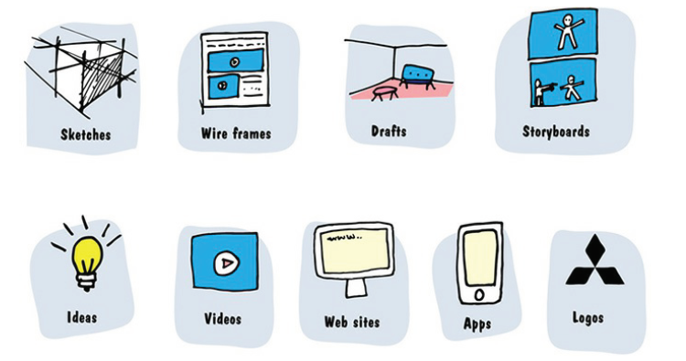
… How do we visualize prototypes for tests in digital tools?

Slide 12
Testing procedures
Test Preparation/Objectives: Where? How? What? Who?
Recruiting users: Conducting the test with users in real context
Document Results
Reflect

Slide 13
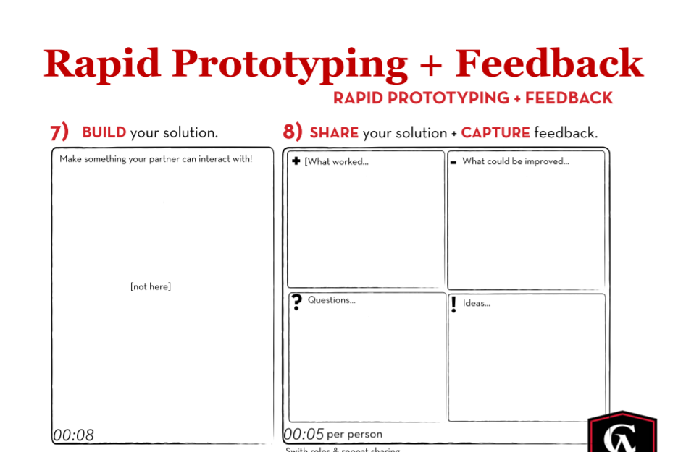
Notes:
The use of a feedback-capture grid has proven quite useful. It facilitates the documentation of feedback, either real-time or from presentations and prototypes.
We use the grid to capture the feedback systematically and deliberately in four main areas.
What do we like?
What wishes do we have?
What questions have cropped up?
Which initial ideas and solutions have we found?
Filling in the four quadrants is pretty easy: We write each piece of
user feedback in the suitable quadrant category.

Slide 14
7. Testing Methods
Cognitive Walkthrough
Evaluation through Expert Analysis/Review Usability experts to inspect the interface
Heuristic Evaluation
Gender Mag Methods
Software Testing
Notes:
Expert Analysis/Review is conducted by those already familiar with Heuristics but do not necessarily follow a set of heuristics. Heuristics based evaluations use various sets of heuristics following them to the core, there Heuristics are based on empirical rules of thumb, best practices, standards, rules, and conventions. For instance Norman Nielsens’ Heuristics which are the most used in usability have sets of questions along a rickert scale

Slide 15
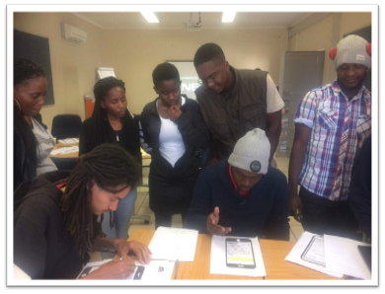
A. Cognitive Walkthrough
The Cognitive Walkthrough is a way to test the usability of interactive software (paper or on finished applications) to identify design issues .
• The cognitive walkthrough focuses on
– Task(s)
– Interface
– Learnability (one kind of usability)
• The cognitive walkthrough may be used
– without “real” users
– before a system is implemented
– with prototypes, wireframes or mockups
Notes:
Cognitive Walkthrough
Who: New user.
What: Performs specific user tasks in line with user goals.
Why: To determine if the sequential processes to get from point A (user task) to point B (user goal) work in the correct order they were designed to.

Slide 16
B. Evaluation through Expert Analysis - Usability experts inspect the interface
Objective –To identify any areas that are likely to cause difficulties.
Application stage –Any stage in the development process: Design, Code, Test and Development.
Advantages –Relatively cheap and fast –Do not require the involvement of users.
Disadvantages –Not assess actual use of the system, assess only whether or not a system upholds accepted usability principles –Often abused by developers that consider themselves to be experts.
Notes:
It is useful when experts within an existing community have the possibility of selecting their field of expertise (e.g., channel marketing, big data analytics, accounting).
This makes it easier in actual practice to obtain fast feedback, such as from the experts with
respect to their expert knowledge.
The dedicated selection of technically accomplished community participants can boost the quality of the feedback, but you should always consider the feedback of non-experts as well; because they are less professionally blinkered, they often have a fresh viewpoint.

Slide 17

C. Heuristic Analysis Steps
Establish an appropriate list of heuristics ...
Select your evaluators ...
Brief your evaluators so they know exactly what they are meant to do and cover during their evaluation ...
First evaluation phase ...
Second evaluation phase.
Notes:
What features of your product are likely to cause usability problems and should be improved.
What features are likely to be successful and should be retained.
What features should be tested with actual users.
Who: System expert.
What: Compares usability to predefined heuristics.
Why: To see if the digital product can be used in a way that is most compatible for users and aligns with recognized usability principles.

Slide 18
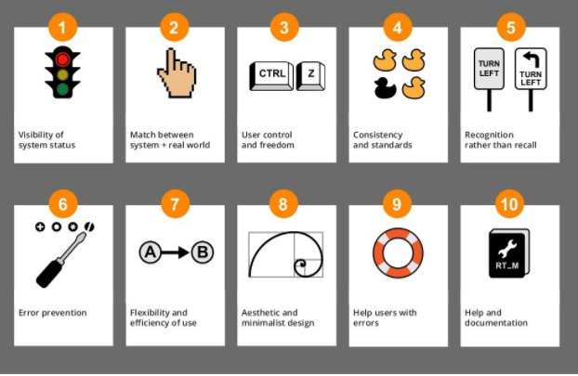
Ten Principles of Usability Testing Heuristic Evaluation
Notes:
Heuristic evaluation is one of the normally used usability testing methods. In a heuristic evaluation, usability experts review your product or web site’s interface and compare it against accepted usability principles. The analysis results in a list of potential usability issues.

Slide 19
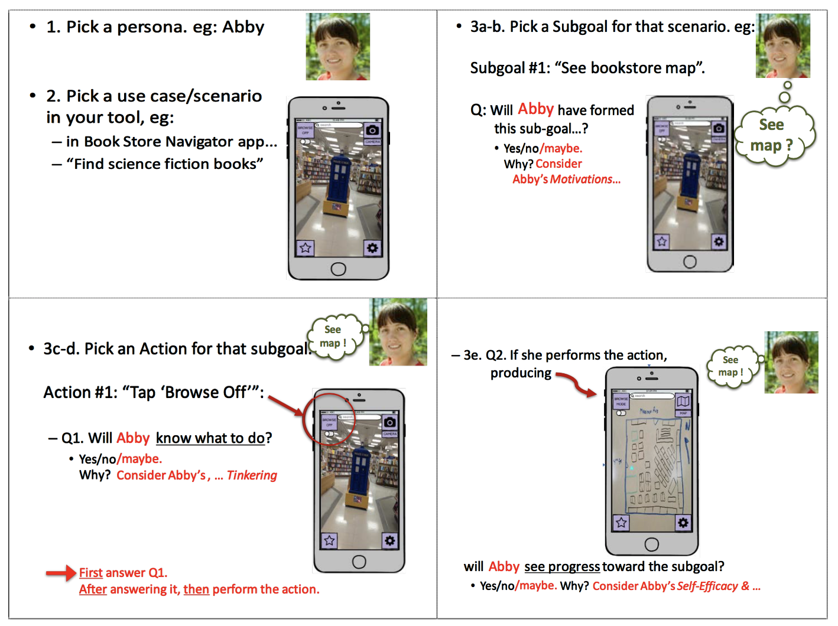
D. The GenderMag Method
Notes:
The core of the GenderMag Method is a gender-specialized cognitive walkthrough and a set of GenderMag personas that focus on five cognitive factors in problem-solving styles.

Slide 20
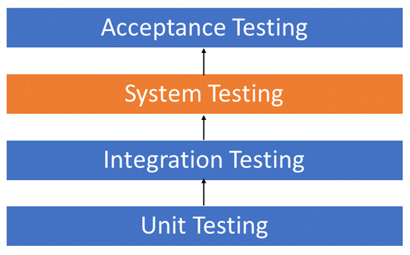
E. Software Testing
Two Category of Software Testing
Black Box Testing
White Box Testing
Notes:
User Testing
Who: End-user.
What: Uses the digital product in realistic circumstances.
Why: To understand how representative users will complete typical tasks in real-life situations.

Slide 21
8. Summary
Testing guarantees that you come back to the essential core of design thinking allowing to Empathize and gain a better knowledge of the user/customer/client;
It may drive a team to new insights that improve the way we Define a design challenge;
It may generate new ideas in the Ideation stage;
and finally, it might lead to an improved iteration of your Prototype.

Slide 22
9. The Takeaway
Let your users compare alternatives
Show, don’t tell: let your users experience the prototype
Ask users to talk through their experience
Observe
Ask follow up questions

Slide 23
10. Task One: Please discuss the following user evaluation/testing methods and where they will be suitable ?
Cognitive Walkthrough
Evaluation through Expert Analysis Usability experts inspect the interface
Heuristic Evaluation
Gender Mag Methods
Software Testing
Which once are you going to use for your group project? And how, give examples?

Slide 24
11. Further readings
Remote User Testing at Vox: http://product.voxmedia.com/2016/5/26/11787530/remote-user-testing-at-vox%20
https://gendermag.org/
https://alannaholeson.com/papers/chi17-GenderMagPersonas-vs-stereotypes.pdf
How to run live user testing Part 3: the debrief
  https://library.launchkit.io/how-to-run-live-user-testing-part-3-the-debrief-d057dbe3a979#.sm6e6vfb3

Slide 25
12. References
Lewrick, M., Link, P., & Leifer, L. (2018). The design thinking playbook: Mindful digital transformation of teams, products, services, businesses and ecosystems. John Wiley & Sons.
Mueller-Roterberg, C. (2018). Handbook of Design Thinking.
Vianna, M., Vianna, Y., Adler, I., Lucena, B., & Russo, B. (2012). Design thinking: Business innovation. MJV Tecnologia ltda, Rio de Janeiro.

Slide 26
"If you are not prepared to be wrong, you will never come up with anything original.”
- Sir Ken Robinson
Thank You!
Questions?

